Slide 1
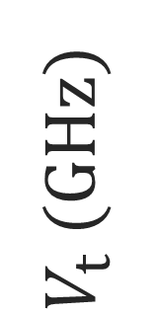
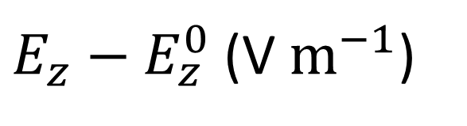
2nd order CT
$V_{t}$ (GHz)
1st order CT
$E_{z}−E_{z}^{0}$(V $m^{−1}$)

